Slide 1

Building Services
Joseph P. Letteri
Director – Building Services

Slide 2
Mission Statement
“The mission of the Building Services Department is to support teaching and learning by providing a safe, clean, comfortable, attractive, and functional environment for the students, staff and citizens of Albemarle County.”

Slide 3
Building Services
The Department is responsible for the School Division’s 26 schools and two service facilities. That is over 2.3 million square feet and 630 acres.
Maintenance
Custodial
Capital Improvement Program
Environmental Management

Slide 4
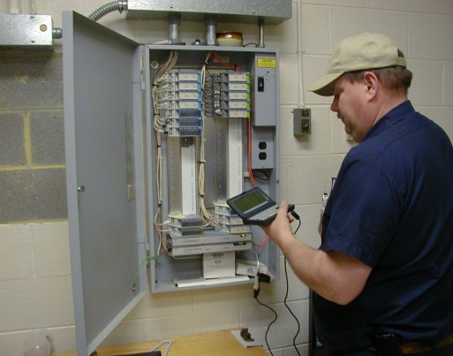
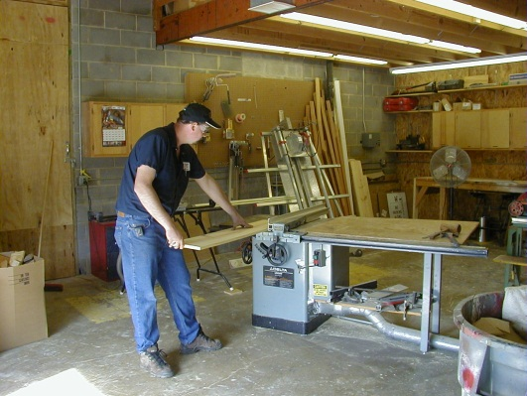
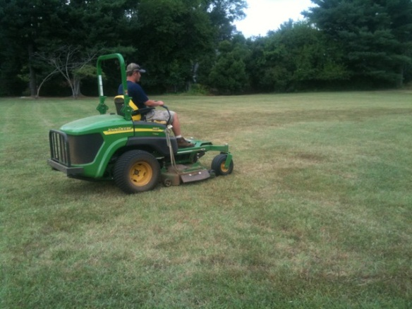
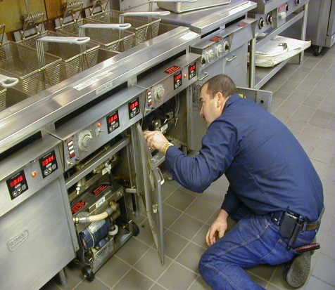
Maintenance
Over 40 employees of the Maintenance Division work throughout the year on various tasks including:
  Carpentry work
  Building automation
  Electrical work
  Mechanical work
  Mowing/grounds
  Moving requests
  Plumbing work
For calendar year 2012, 12,994 work requests were submitted and 96% were completed.
Notes:
Calendar Year: January 1, 2012 – December 31, 2012.
All work orders are prioritized and the 500 not complete are not critical
That’s over 1000 work orders per month

Slide 5
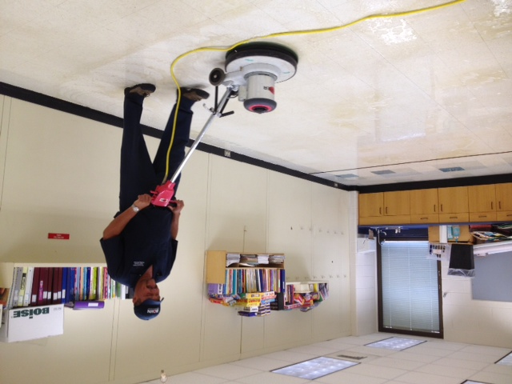
Custodial
Over 140 employees of the Custodial Division work throughout the year on various tasks including:
  Opening and closing the facilities.
  Cleaning 2.3 million square feet daily.
  Vacuuming
  Sanitizing
  Trash/ Recyclables removal.
  Light bulb replacement.
  Moving furniture.
  Rentals and event coverage.

Slide 6
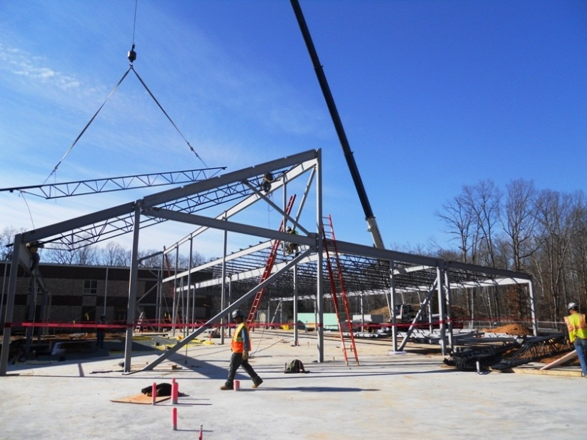
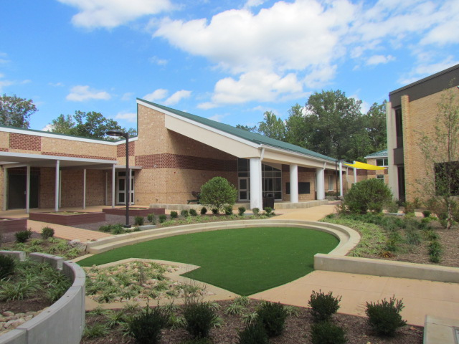
Capital Improvement Program
Our department oversees the budgeting, planning and management of the School Division’s Capital Improvement Program (CIP)

Slide 7
Capital Improvement Program
Key capital projects in FY 13/14 will include:
  Renovation of Murray High School (front wing)
  ~$4.5 million Maintenance Program (including roof replacements, HVAC upgrades, etc.)
  Contemporary Learning Spaces & Design 2015 Grant Program
  Design of the Agnor-Hurt Addition
Notes:
These capital funds are not part of our operating budget but the staff to manage it is.

Slide 8

Environmental Management
The Building Service’s Department is responsible for the Division’s Environmental Management System including:
  Environmental compliance.
  Asbestos management.
  Well water testing.
  Energy and conservation.
  Indoor Air Quality.
  Recycling collection.
  Integrated Pest Management.
  Hazardous storage and disposal.
Notes:
Energy Star:
Definition: Energy Star is a United States government program created in 1992 by the US Environmental Protection Agency in an attempt to reduce energy consumption and greenhouse gas emission by power plants. What began originally as a voluntary labeling program has grown in to one of the largest efforts worldwide to promote energy efficient consumer products.
Architects and owners can select an energy target from either the 1-to-100 EPA rating scale or 50 to 90 percent energy reduction compared to an average building. Projects that receive a rating of 75 or higher are eligible for Earn the ENERGY STAR.
We currently have 22 Energy Star Sites.

Slide 9
Budget Summary
Personnel (178.69 FTE) $6,118,279 2.06% increase
Benefits $2,280,302 3.90% increase
Operations $5,181,171 0.42% increase
Capital $ 279,350 0.07% increase
Initiative $ 144,000 .00% increase
Total Request $14,003,102 2.75% increase
Notes:
Initiative: $144,000 for the Seminole Storage Facility Lease (CIP).
The overall increase is in Line with Dr. Moran's request.
Overall we are adequately staffed.
Our largest expense is personnel and benefits costs.
Utilities is also a significant portion of our operational budget, followed by Repair/Maintenance materials and supply costs.

Slide 10
Utility Consumption Trends
Oil has been multiplied by 100 for visual affect.
Notes:
AHS & BRN Additions: Substantial Completion - August, 2009.
Turf Fields
Monticello Turf Field : Completion Date August 2009
AHS and WAHS – Substantial Completion Date: February 2011

Slide 11
FY13/14 Utilities Request
Projected Rates:
Electric: $0.104/kWh
Gas: $0.014/cf
Fuel Oil: $3.58/gal
Water: $0.015/gal
Irrigation: $0.012/gal
Notes:
Represents 60% of our operating budget ($5,181,171/ $3,092,257)

Slide 12
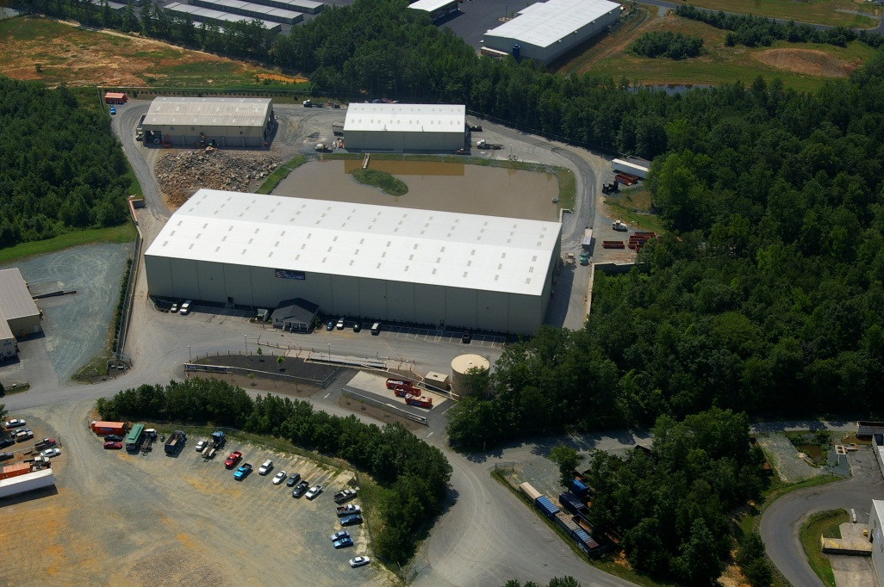
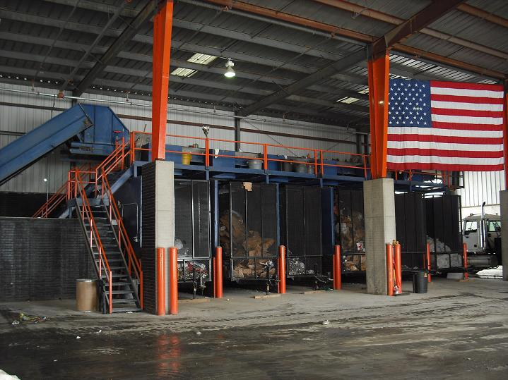
Refuse Collection
Single Stream Waste and Recycling
Now utilizing the Mixed Waste Materials Recovery System offered by van der Linde Recycling.
Significantly increasing
recycle rates and reducing collection and labor costs.
Notes:
Cost Decreased by 24%
FY 13 = $138,000
FY 14 = $105,000

Slide 13
Thank you for your continued support!
Questions ?

